Slide 1

Operations Management and Quality
Chapter Seven:

Slide 2
Objectives:
Explain the meaning of the term production or operations.
Describe the three kinds of utility created by operations and the difference between goods and services production
Explain how companies with different business strategies are best served by having different operations capabilities.
Identify the major factors that are considered in operations planning.
Discuss the information contained in four kinds of operations schedules.
Discuss the two key activities required for operations control.
Discuss the total quality management.
Explain how a supply chain strategy differs from traditional strategies.

Slide 3

What Does Operations Mean?
Operations (Production)
  activities involved in making products — goods and services — for customers

Slide 4

What Does Operations Mean?
Service Operations (Service Production)
  activities producing intangible and tangible products, such as entertainment, transportation, and education
Goods Operations (Goods Production)
  activities producing tangible products, such as radios, newspapers, buses, and textbooks
Notes:
goods are produced; services are performed.

Slide 5
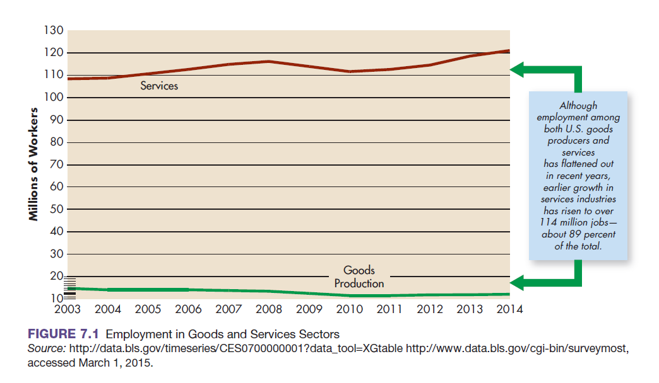
Growth in the Services and Goods Sectors
Notes:
As you can see from Figure 7.1, employment has risen significantly in the service sector and has leveled off at just 11 to 12 percent in goods-producing industries for years 2003 through 2014. Much of this growth comes from e-commerce, business services, health care, amusement and recreation, and education. By 2011, the service sector’s growth generated about 68 percent of private-sector national income.

Slide 6
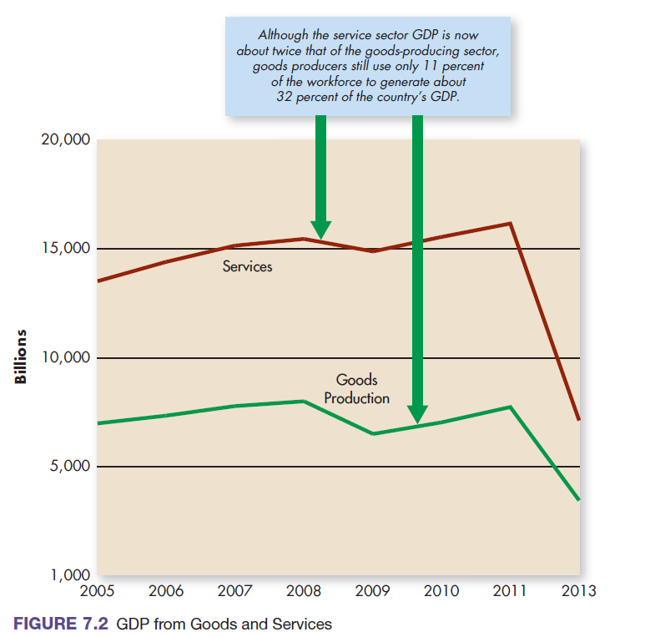
GDP from Goods and Services
Notes:
As Figure 7.2 shows, the service sector’s greater percentage of GDP has hovered above 65 percent in recent years. At the same time, the smaller 11 percent of the workforce in goods-producing jobs produced 32 percent of national income.

Slide 7
Creating Value Through Operations
Utility
  product’s ability to satisfy a human want or need
Form Utility
Time Utility
Place Utility
converting raw materials and human skills into finished goods and services, production creates form utility
adds customer value by making products available when consumers want them.
Making products available where they are convenient for consumers.
Notes:
• Production makes products available: By converting raw materials and human skills into finished goods and services,
production creates form utility, as when Regal Cinemas combines building materials, theater seats, and projection equipment
to create entertainment.
• When a theater offers midday, afternoon, and evening shows seven days a week, it creates time utility;
that is, it adds customer value by making products available when consumers want them.
• When a theater offers a choice of 15 movies, all under one roof at a popular location, it creates place utility:
it makes products available where they are convenient for consumers.

Slide 8
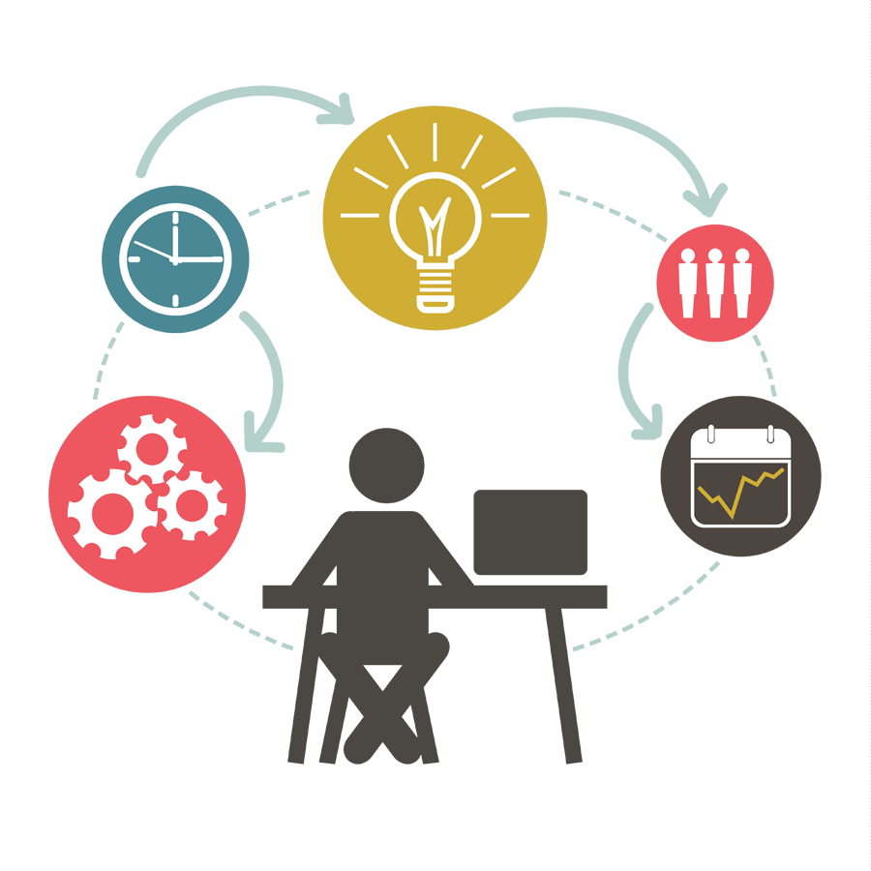
Creating Value Through Operations (Cont)
Operations (Production) Management
  systematic direction and control of the activities that transform resources into finished products that create value for and provide benefits to customers
Operations (Production) Managers
  managers responsible for ensuring that operations activities create value and provide benefits to customers

Slide 9
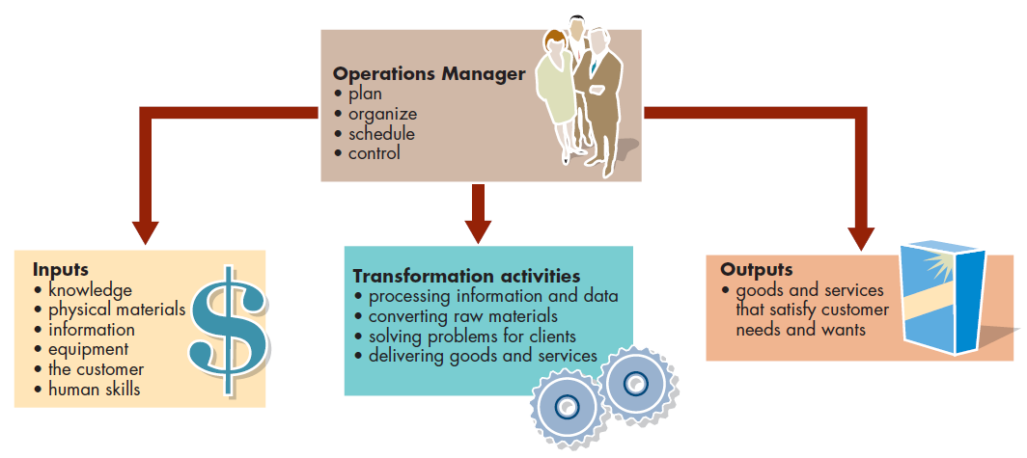
The Resource Transformation Process
Notes:
As the figure shows, operations managers draw up plans to transform resources into products.
First, they bring together basic resources: knowledge, physical materials, information, equipment, the customer, and human skills.
Then they put them to effective use in a production facility. As demand for a product increases, they schedule and control work
to produce the required amount. Finally, they control costs, quality levels, inventory, and facilities and equipment.

Slide 10
Differences between Service and Goods Manufacturing Operations
Interacting with customers
The intangible and unstorable nature of some services
The customer’s presence in the process
Service quality considerations
Notes:
There are several obvious differences between service and manufacturing operations. Four aspects of service operations can make service production more complicated than simple goods production: (1) interacting with customers, (2) the intangible and unstorable nature of some services, (3) the customer’s presence in the process, and (4) service quality considerations.

Slide 11
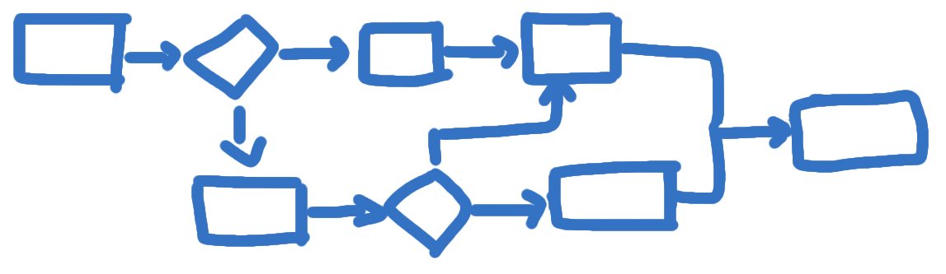
Operations Process
set of methods and technologies used to produce a good or a service
Notes:
An operations process is a set of methods and technologies used to produce a good or a service. Banks, for example, use two processes—document shredding and data encryption—to protect confidential information. Automakers use precision painting methods (equipment and materials) to produce a glittering paint finish.

Slide 12
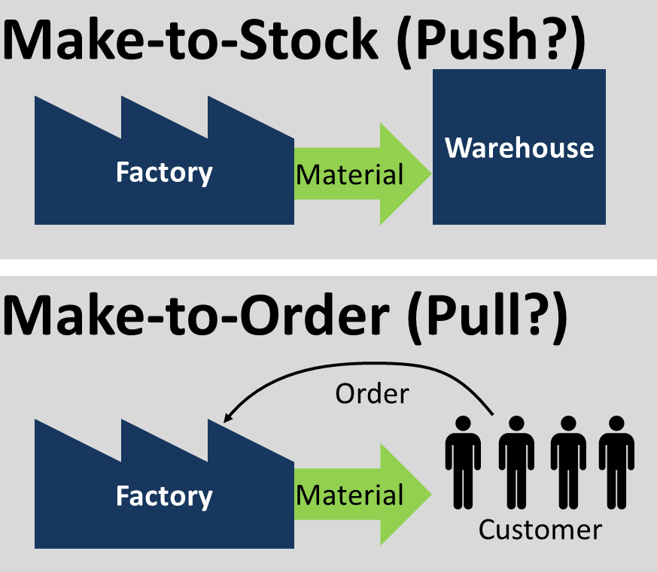
Goods Production Processes
Make-to-Order Operations
  activities for one-of-a-kind or custom-made production
Make-to-Stock Operations
  activities for producing standardized products for mass consumption
Notes:
Clothing, such as evening gowns, is available either off-the-shelf in department stores or custom-made at a designer or tailor shop. The designer or tailor’s make-to-order operations respond to one-of-a-kind gown requirements, including unique patterns, materials, sizes, and shapes, depending on customers’ characteristics. Make-to-stock operations, in contrast, produce standard gowns in large quantities to be stocked on store shelves or in displays for mass consumption.

Slide 13
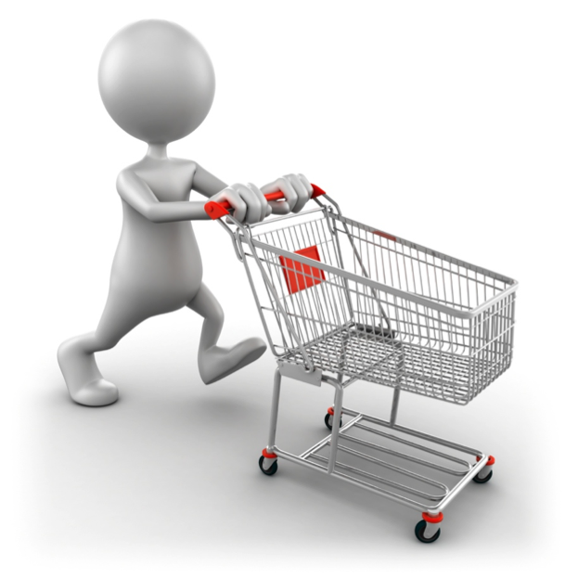
Service Production Processes: Extent of Customer Contact
Low-Contact System
  level of customer contact in which the customer need not be part of the system to receive the service
High-Contact System
  level of customer contact in which the customer is part of the system during service delivery
Notes:
Low-Contact Systems Consider the postal delivery operations at your local U.S. post office. Postal employees gather mail, sort it, and send it on its delivery journey to addressees. This operation is a low-contact system: Customers are not in contact with the post office while the service is performed. They receive the service— mail sent and mail received—without setting foot in the processing center.
High-Contact Systems Think about your local public transit system. The service is transportation; when you purchase transportation, you board a bus or train. For example, the Bay Area Rapid Transit (BART) system, which connects San Francisco with outlying suburbs is, like all public transit systems, a high-contact system.
a low-contact system, the service buyer doesn’t have to be present during the transaction; in a high-contact system, customers are part of the system.

Slide 14
Business Strategy Determines
Operations Capabilities
Operations Capability (Production Capability)
  special ability that production does especially well to outperform the competition
Excellent firms learn, over time, how to achieve more than just one competence

Slide 15
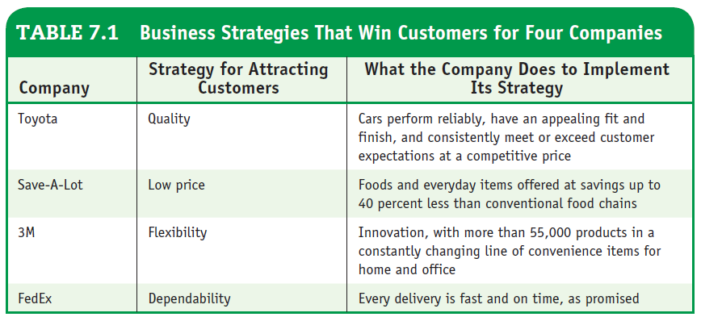
Business Strategies That Win Customers for Four Companies
Notes:
Consider the four firms listed in the table are in goods production (Toyota and 3M), and two are in services.
These companies have contrasting business strategies and, as we shall see, they have chosen different operations capabilities.
All four firms have been successful, but they’ve taken quite different operations paths to get there.
Each company has identified a business strategy that it uses for attracting customers in its industry.

Slide 16
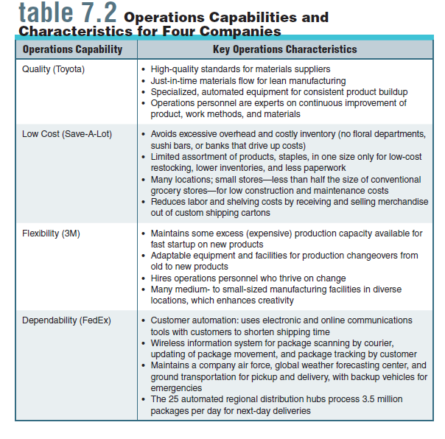
Operations Capabilities and
Characteristics for Four Companies
Notes:
Consider the four firms listed in the table are in goods production (Toyota and 3M), and two are in services.
These companies have contrasting business strategies and, as we shall see, they have chosen different operations capabilities.
All four firms have been successful, but they’ve taken quite different operations paths to get there.
Each company has identified a business strategy that it uses for attracting customers in its industry.

Slide 17
Operations Planning
Capacity
  amount of a product that a company can produce under normal conditions
Capacity Planning
  determining the amount of a product that a company can produce under normal conditions
Location Planning
  determining where production will happen based on costs and flexibility
Layout Planning
  planning for the layout of machinery, equipment, and supplies
Notes:
operations planning includes capacity planning, location planning, layout planning, quality planning, and methods planning.
Capacity Planning
determining the amount of a product that a company can produce under normal conditions
Location Planning
determining where production will happen based on costs and flexibility
Layout Planning
planning for the layout of machinery, equipment, and supplies
Quality planning
deciding what constitutes a high-quality product and determining how to measure these quality characteristics
Methods planning
managers must identify each production step and the specific methods for performing it
can reduce waste and inefficiency by examining procedures on a step-by-step basis

Slide 18
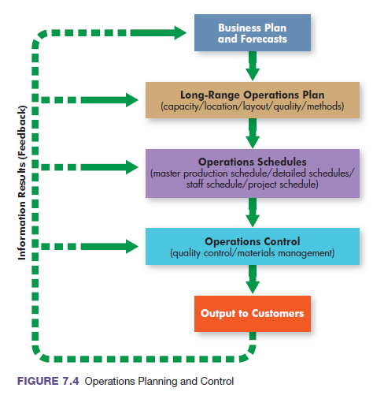
Operations Planning and Control
Notes:
Let’s turn now to a discussion of production activities and resources that are considered in every business organization. Like all good managers, we start with planning. Managers from many departments contribute to decisions about operations. As Figure 7.4 shows, however, no matter how many decision makers are involved, the process is a logical sequence of decisions.

Slide 19
Layout Planning
Process Layout (Custom-Product Layout)
  physical arrangement of production activities that groups equipment and people according to function
Product Layout (Same-Steps Layout)
  physical arrangement of production steps designed to make one type of product in a fixed sequence of activities according to its production requirements
Assembly Line Layout
  a same-steps layout in which a product moves step by step through a plant on conveyor belts or other equipment until it is completed
Fixed-Position Layout
  labor, equipment, materials, and other resources are brought to the geographic location where all production work is done
Notes:
In a process layout (also called custom-product layout), which is well suited to make-to-order shops (or job shops) specializing in custom work, equipment and people are grouped according to function. FedEx Office stores (formerly Kinko’s Copy Centers), for example, use custom-products layouts to accommodate a variety of custom jobs.
A product layout (also called a same-steps layout or assembly line layout) is set up to provide one type of service or make one type of product in a fixed sequence of production steps. All units go through the same set of steps.

Slide 20
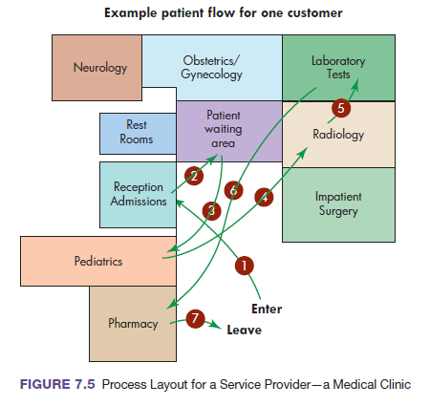
Process Layout for a Service Provider
Notes:
Figure 7.5 shows the process layout of a service provider—a medical clinic. The path taken through the facility reflects the unique treatments for one patient’s visit.

Slide 21
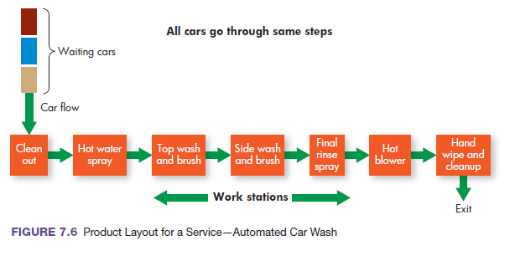
Product Layout for a Service (Same Steps Layout)

Slide 22
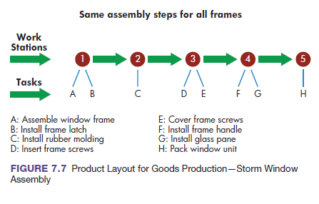
Product Layout for Goods Production

Slide 23
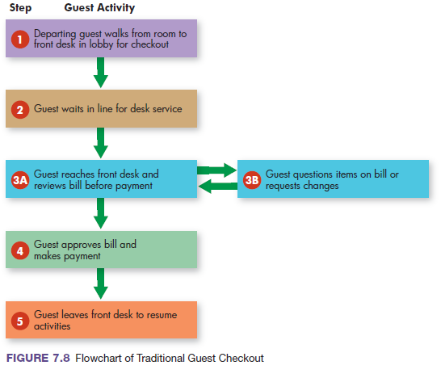
Flowchart of Traditional Guest Checkout

Slide 24
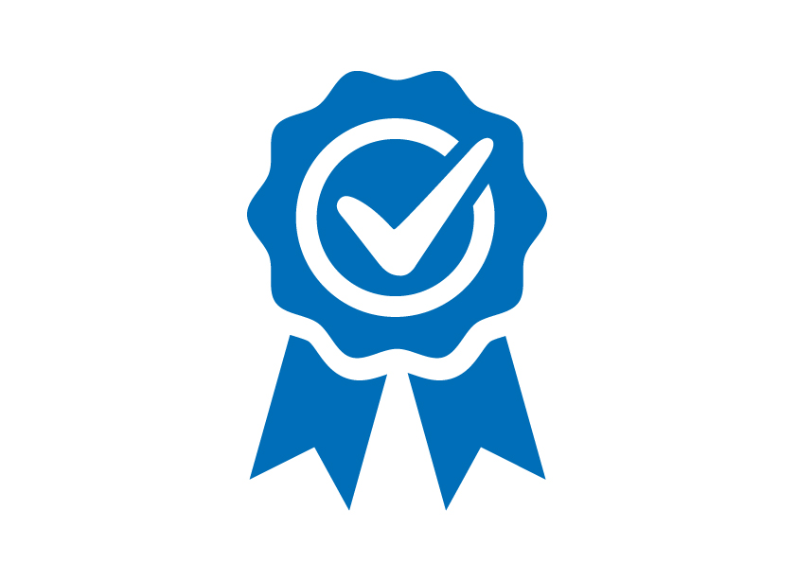
Quality Planning
Quality
  combination of “characteristics of a good or service that bear on its ability to satisfy stated or implied needs”
Performance
  dimension of quality that refers to how well a product does what it is supposed to do
Consistency
  dimension of quality that refers to sameness of product quality from unit to unit

Slide 25
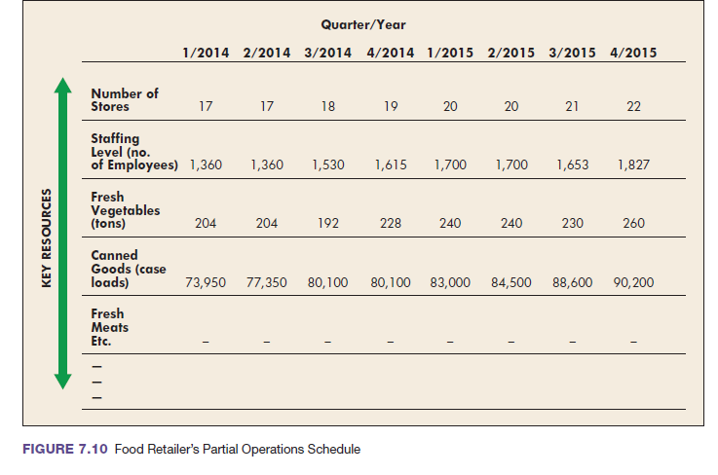
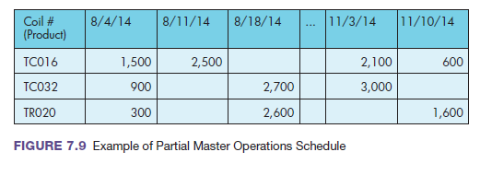
Operations Scheduling
Master schedule
  “the game plan” for upcoming production
Notes:
Scheduling of operation occurs at different levels. First, a top-level master operations schedule shows which services or products will be produced and when, in upcoming time periods.
Although the master production schedule is the backbone for overall scheduling, additional information comes from detailed schedules, schedules showing daily work assignments with start and stop times for assigned jobs at each work station.

Slide 26
Operations Scheduling (Cont)
Detailed schedules
  show day-to-day activities that will occur in production

Slide 27

Operations Scheduling (Cont)
Staff schedules
  identify who and how many employees will be working, and when
Project schedules
  provide coordination for completing large-scale projects

Slide 28
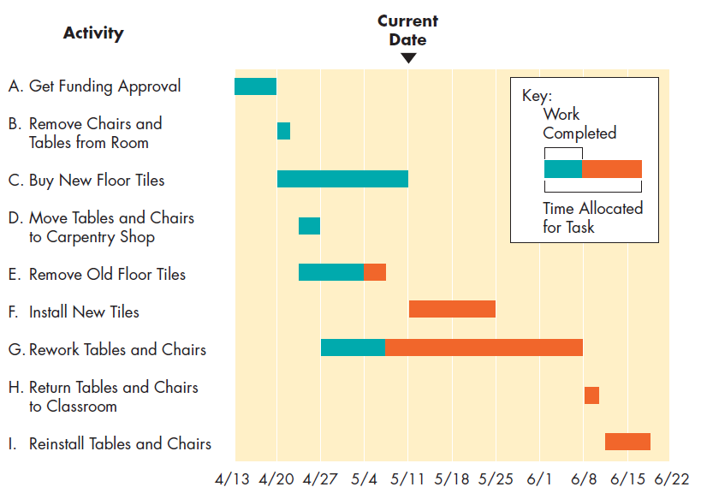
Project Scheduling: Gantt Chart
Gantt Chart
  production schedule that breaks down large projects into steps to be performed and specifies the time required to perform each step
Notes:
A Gantt chart breaks down large projects into steps to be performed and specifies the time required to perform each one.
The project manager lists all activities needed to complete the work, estimates the time required for each step,
records the progress on the chart, and checks the progress against the time scale on the chart to keep the project moving on schedule.
Figure shows a Gantt chart for the renovation of a college classroom. It shows progress to date and schedules for remaining work.
It also shows that some steps can be performed at the same time (e.g., step D can be performed during the same time
as steps C and E), but others cannot (e.g., step A must be completed before any of the others can begin).
Step E is behind schedule; it should have been completed before the current date.

Slide 29
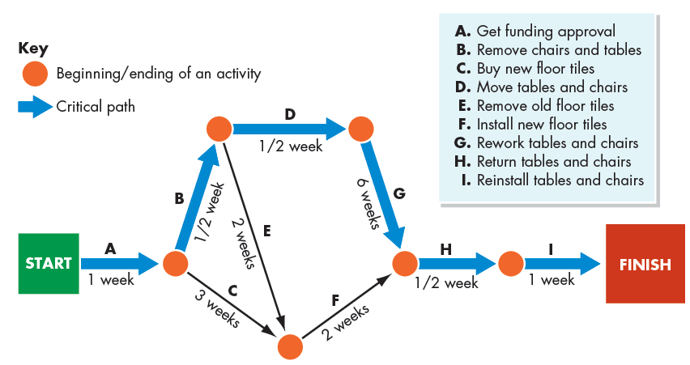
Project Scheduling: PERT Chart
PERT Chart
  production schedule specifying the sequence of activities, time requirements, and critical path for performing the steps in a project
Notes:
Figure shows a PERT chart for renovating the college classroom. The project’s nine activities
and the times required to complete them are identified. Each activity is represented by an arrow.
The arrows are positioned to show the required sequence for performing the activities.
Figure 7.12 shows a PERT chart for renovating the college classroom. The project’s nine activities and the times required to complete them are identified. Each activity is represented by an arrow. The arrows are positioned to show the required sequence for performing the activities.

Slide 30

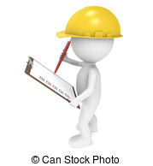
Operations Control
Operations Control
  process of monitoring production performance by comparing results with plans and taking corrective action when needed
Follow-Up
  operations control activity for ensuring that production decisions are being implemented

Slide 31
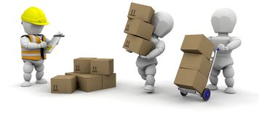
Materials Management
Operations control includes
Materials Management and Quality Control. Both activities ensure that
schedules are met and products delivered, both in quantity and in quality.
Materials management
  the process by which managers plan, organize, and control the flow of materials from sources of supply through distribution of finished goods
Notes:
Most of us have difficulty keeping track of personal items now and then—clothes, books, cell phones, and so on. Imagine keeping track of thousands, or even millions, of things at any one time. That’s the challenge in materials management, the process by which managers plan, organize, and control the flow of materials from sources of supply through distribution of finished goods. For manufacturing firms, typical materials costs make up 50 to 75 percent of total product costs.

Slide 32
Materials Management Activities for
Physical Goods
Supplier Selection
  process of finding and choosing suppliers from whom to buy
  It includes evaluating potential suppliers, negotiating terms of service, and maintaining positive buyer–seller relationships.
Purchasing
  acquisition of the materials and services that a firm needs to produce its products
  Most large firms have purchasing departments to buy proper services and materials in the amounts needed.
Notes:
Supplier selection is the process of finding and choosing suppliers of services and materials. This step includes evaluating potential suppliers, negotiating terms of service, and maintaining positive buyer–seller relationships.
Purchasing is the acquisition of all the raw materials and services that a company needs to produce its products. Most large firms have purchasing departments to buy proper services and materials in the amounts needed.

Slide 33
Materials Management Activities for
Physical Goods (Cont)
Transportation
  activities in transporting resources to the producer, and finished goods to customers
Warehousing
  storage of incoming materials for production and finished goods for distribution to customers
Inventory Control
  process of receiving, storing, handling, and counting of all raw materials, partly finished goods, and finished goods
  It ensures that enough materials inventories are available to meet production schedules, while at the same time avoiding expensive excess inventories.
Notes:
Inventory control includes the receiving, storing, handling, and counting of all raw materials, partly finished goods, and finished goods. It ensures that enough materials inventories are available to meet production schedules, while at the same time avoiding expensive excess inventories.

Slide 34
Materials Management
Lean Production System
  production system designed for smooth production flows that avoid inefficiencies, eliminate unnecessary inventories, and continuously improve production processes
Just-in-Time (JIT) Production
  type of lean production system that brings together all materials at the precise time they are required at each production stage
Notes:
Managers must take timing into consideration when managing materials, as well. Pioneered by Toyota, lean production systems are designed for smooth production flows that avoid inefficiencies, eliminate unnecessary inventories, and continuously improve production processes.
Just-in-time (JIT) production, a type of lean system, brings together all needed materials at the precise moment they are required for each production stage, not before, thus creating fast and efficient responses to customer orders. All resources flow continuously—from arrival as raw materials to final assembly and shipment of finished products.
The Seven Wastes
In lean manufacturing there are generally considered to be seven types of waste.
Over-production against plan
Waiting time of operators and machines
Unnecessary transportation
Waste in the process itself
Excess stock of material and components
Non value-adding motion
Defects in quality

Slide 35
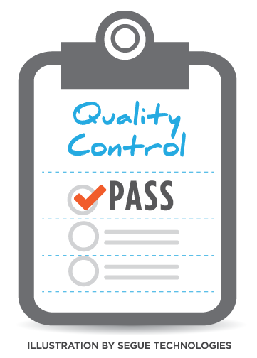

Quality Control
taking action to ensure that operations produces products that meet specific quality standards
requires establishment of specific standards and measurements
Notes:
Quality control is taking action to ensure that operations produce goods or services that meet specific quality standards. Consider, for example, service operations in which customer satisfaction depends largely on the employees who provide the service. By monitoring services, managers and other employees can detect mistakes and make corrections.

Slide 36
The Quality-Productivity Connection
Productivity
  the amount of output produced compared with the amount of resources used to produce that output
It’s no secret that quality and productivity are watchwords in today’s competitive environment. Companies are not only measuring productivity and insisting on improvements; they also are requiring that quality brings greater satisfaction to customers, improves sales, and boosts profits.
Notes:
It’s no secret that quality and productivity are watchwords in today’s competitive environment. Companies are not only measuring productivity and insisting on improvements; they also are requiring that quality brings greater satisfaction to customers, improves sales, and boosts profits.
Productivity is a measure of economic performance: It compares how much we produce with the resources we use to produce it. The formula is fairly simple. The more services and goods we can produce while using fewer resources, the more productivity grows and the more everyone—the economy, businesses, and workers— benefits.

Slide 37
Managing for Quality
Total Quality Management (TQM)
  all activities involved in getting high-quality goods and services into the marketplace
Quality Ownership
  principle of total quality management that holds that quality belongs to each person who creates it while performing a job
Notes:
Total quality management (TQM) includes all the activities necessary for getting high-quality goods and services into the marketplace. TQM begins with leadership and a desire for continuously improving both processes and products. It must consider all aspects of a business, including customers, suppliers, and employees. To marshal the interests of all these stakeholders, TQM first evaluates the costs of poor quality. TQM then identifies the sources causing unsatisfactory quality, assigns responsibility for corrections, and ensures that those who are responsible take steps for improving quality.
The backbone of TQM, however, and its biggest challenge, is motivating all employees and the company’s suppliers to achieve quality goals. Leaders of the quality movement use various methods and resources to foster a quality focus, such as training, verbal encouragement, teamwork, and tying compensation to work quality. When those efforts succeed, employees and suppliers will ultimately accept quality ownership, the idea that quality belongs to each person who creates it while performing a job.

Slide 38
Tools for Total Quality Management
Competitive Product Analysis
  process by which a company analyzes a competitor’s products to identify desirable improvements
Value-Added Analysis
  process of evaluating all work activities, materials flows, and paperwork to determine the value that they add for customers
Quality Improvement Team
  TQM tool in which collaborative groups of employees from various work areas work together to improve quality by solving common shared production problems
Notes:
Hundreds of tools have proven useful for quality improvement, ranging from statistical analysis of product data, to satisfaction surveys of customers, to competitive product analysis, a process by which a company analyzes a competitor’s products to identify desirable improvements.
Value-added analysis refers to the evaluation of all work activities, materials flows, and paperwork to determine the value that they add for customers. It often reveals wasteful or unnecessary activities that can be eliminated without jeopardizing customer service.
Companies throughout the world have adopted quality improvement teams, which are patterned after the successful Japanese concept of quality circles, collaborative groups of employees from various work areas who meet regularly to define, analyze, and solve common production problems. The teams’ goal is to improve both their own work methods and the products they make. Quality improvement teams organize their own work, select leaders, and address problems in the workplace.

Slide 39
Tools for Total Quality Management (cont.)
ISO 9000
  program certifying that a factory, laboratory, or office has met the quality management standards set by the International Organization for Standardization
ISO 14000
  certification program attesting to the fact that a factory, laboratory, or office has improved its environmental performance
Business Process Reengineering
  rethinking and radical redesign of business processes to improve performance, quality, and productivity
Notes:
ISO 9000 ISO 9000 is a certification program attesting that a factory, a laboratory, or an office has met the rigorous quality management requirements set by the International Organization for Standardization (ISO). Today, more than 160 countries have adopted ISO 9000 as a national standard. Nearly 1 million certificates have been issued to organizations worldwide meeting the ISO standards.
The ISO 14000 program certifies improvements in environmental performance by requiring a firm to develop an environmental management system: a plan documenting how the company has acted to improve its performance in using resources (such as raw materials) and in managing pollution. A company must not only identify hazardous wastes that it expects to create, but it must also stipulate plans for treatment and disposal.
Business process reengineering focuses on improving a business process—rethinking each of its steps by starting from scratch. Reengineering is the fundamental rethinking and radical redesign of business processes to achieve dramatic improvements as measured by cost, quality, service, and speed.

Slide 40
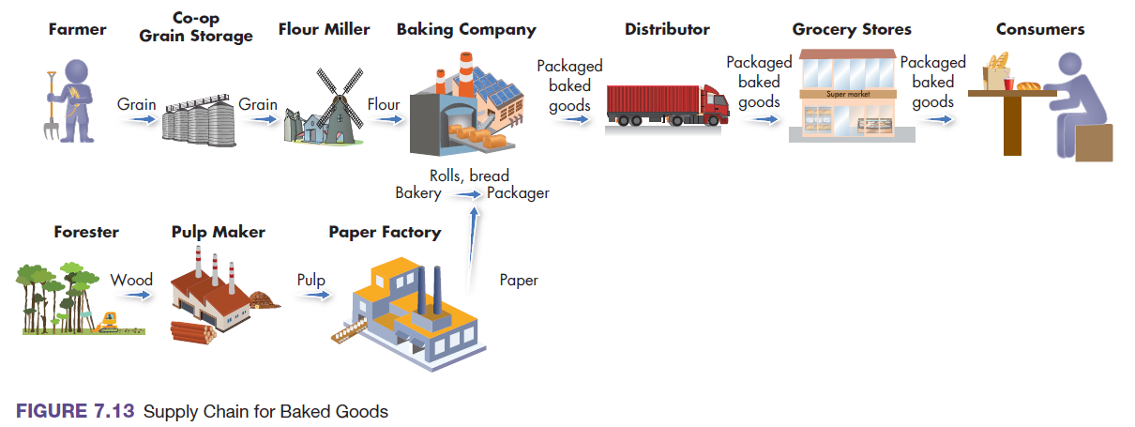
Adding Value Through Supply Chains
Supply Chain (Value Chain)
  flow of information, materials, and services that starts with raw-materials suppliers and continues adding value through other stages in the network of firms until the product reaches the end customer
Supply Chain Management (SCM)
  principle of looking at the supply chain as a whole to improve the overall flow through the system
Supply Chain
Notes:
The term supply chain refers to the group of companies and stream of activities that work together to create a product. A supply chain (or value chain) for any product is the flow of information, materials, and services that starts with raw-materials suppliers and continues adding value through other stages in the network of firms until the product reaches the end customer.
Supply chain management (SCM) looks at the chain as a whole to improve the overall flow through a system composed of companies working together. Because customers ultimately get better value, supply chain management gains competitive advantage for each of the chain’s members.
Figure 7.13 shows the chain of activities for supplying baked goods to consumers. Each stage adds value for the final customer.

Slide 41
Outsourcing and Global Supply Chains
Outsourcing
  replacing internal processes by paying suppliers and distributors to perform business processes or to provide needed materials or services
Notes:
Outsourcing is the strategy of paying suppliers and distributors to perform certain business processes or to provide needed materials or services. The decision to outsource expands supply chains. The movement of manufacturing and service operations from the United States to countries such as China, Mexico, and India has reduced U.S. employment in traditional jobs. It has also created new operations jobs for SCM.

Slide 42
References
Griffin, R. W., & Ebert, R. J. (2016). Business Essentials, Global Edition, 11th Edition. Pearson Education.

