Slide 1
Organic Halogen Compounds

Slide 2
Classification
Alkyl halides: are compounds contain the C-X bond where X is a halogen (F, Cl, Br or I)
These may be classified as mono, di, or polyhalogen (tri-,tetra-, etc.) compounds depending on whether they contain one, two or more halogen atoms in their structures
Monohalocompounds
According to hydrocarbon gp.
1-Alkyl halides or haloalkanes( R-X) 2-Allylic halides
3-Vinylic halides 4-Benzylic halides
5-Aryl halides or haloarenes

Slide 3
1-Alkyl halides or haloalkanes( R-X)
has a halogen atom bonded to one of the sp³ hybrid atoms of an alkyl group, depending on the type of carbon to which the halogen is attached
Primary alkyl halide 1° CH₃-X and R-CH₂-X
Secondary alkyl halide 2° (R)₂-CH-X
Tertiary alkyl halide 3° (R)₃-C-X
compound | CH₃-Cl | (CH₃)₂-CH-F
Common | Methyl Chloride | Isopropyl fluoride | t.Butyl bromide
IUPAC | Chloromethane | 2-Fluoropropane | 2-Bromo-2-methylpropane
Class | 1° | 2° | 3°

Slide 4
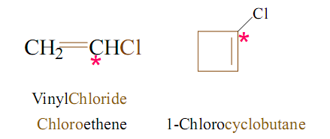
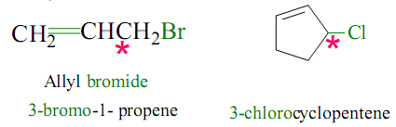
2-Vinylic halides
has a halogen atom bonded to one of the sp² hybrid carbon atoms of an alkene (C=C)
1-Chlorocyclobutene
3-Allylic halides
has a halogen atom bonded to carbon sp³ next to a double bond carbon

Slide 5
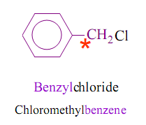
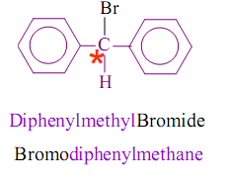
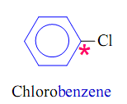
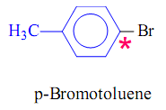
4-Benzylic halides
Ar-C-X ( has a halogen atom bonded to carbon sp³ hybrid next to aromatic ring)
5-Aryl halides (haloarene)
Ar-X has a halogen atom bonded to one of the sp² hybrid carbon atoms of an aromatic ring (X directly attached to ∅ )

Slide 6
Polyhalogen compounds are carbon compounds containing more than one halogen atom. Many polyhalogen compounds are useful in the industry and in agriculture.

Slide 7
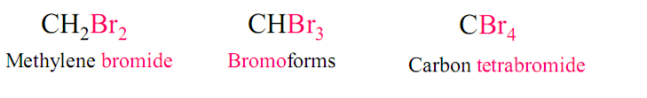
Common name OF Alkyl halides
Common names derived from the corresponding alkyl group followed by the name of halogen atom.

Slide 8
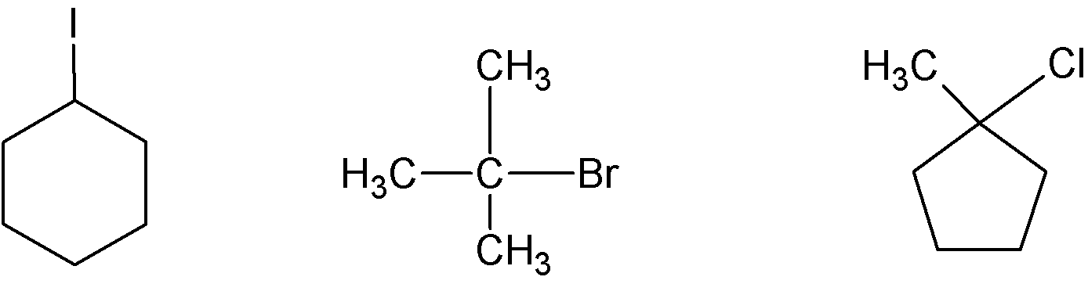
Nomenclature OF Alkyl halides
IUPAC names derived from the names of parent organic compound (alkane or alkene or alkyne or alcohol or aldehydes and so on) with a prefix indicating halogens and their positions. (Halo……)
CH₃-Cl CH₃-CH₂-Br (CH₃)₂-CH-F
Common Methyl Chloride Ethyl bromide Isopropyl fluoride
IUPAC Chloromethane Bromoethane 2-Fluoropropane
Class 1° 1° 2°
Common Cyclohexyl Iodide t-Butyl bromide Methylcyclopentyl chloride
IUPAC Iodocyclohexane 2-Bromo-2- methylpropane 1-Chloro-1-methyl cyclopentane
Class 2° 3 ° 3 °

Slide 9
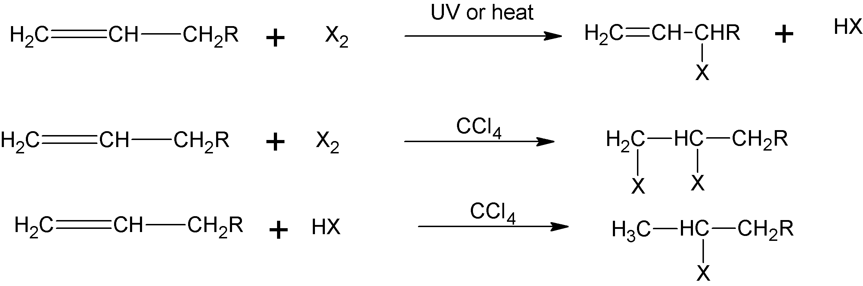
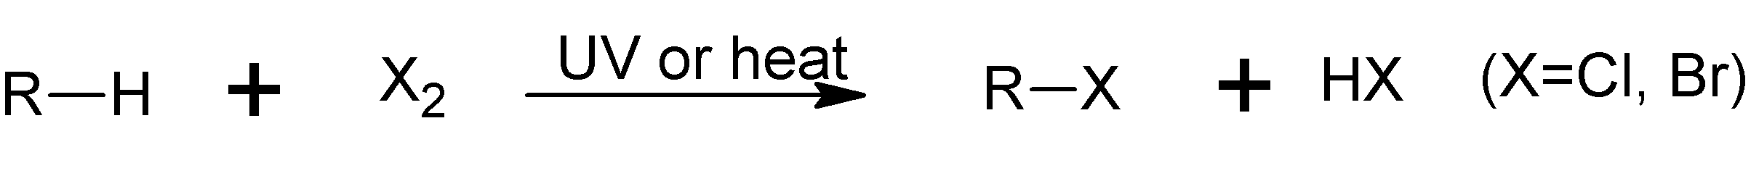
Preparation Of Halocompounds
1- Direct Halogenation Of Hydrocarbons
a) Halogenation of alkanes
b) Halogenation of alkenes

Slide 10
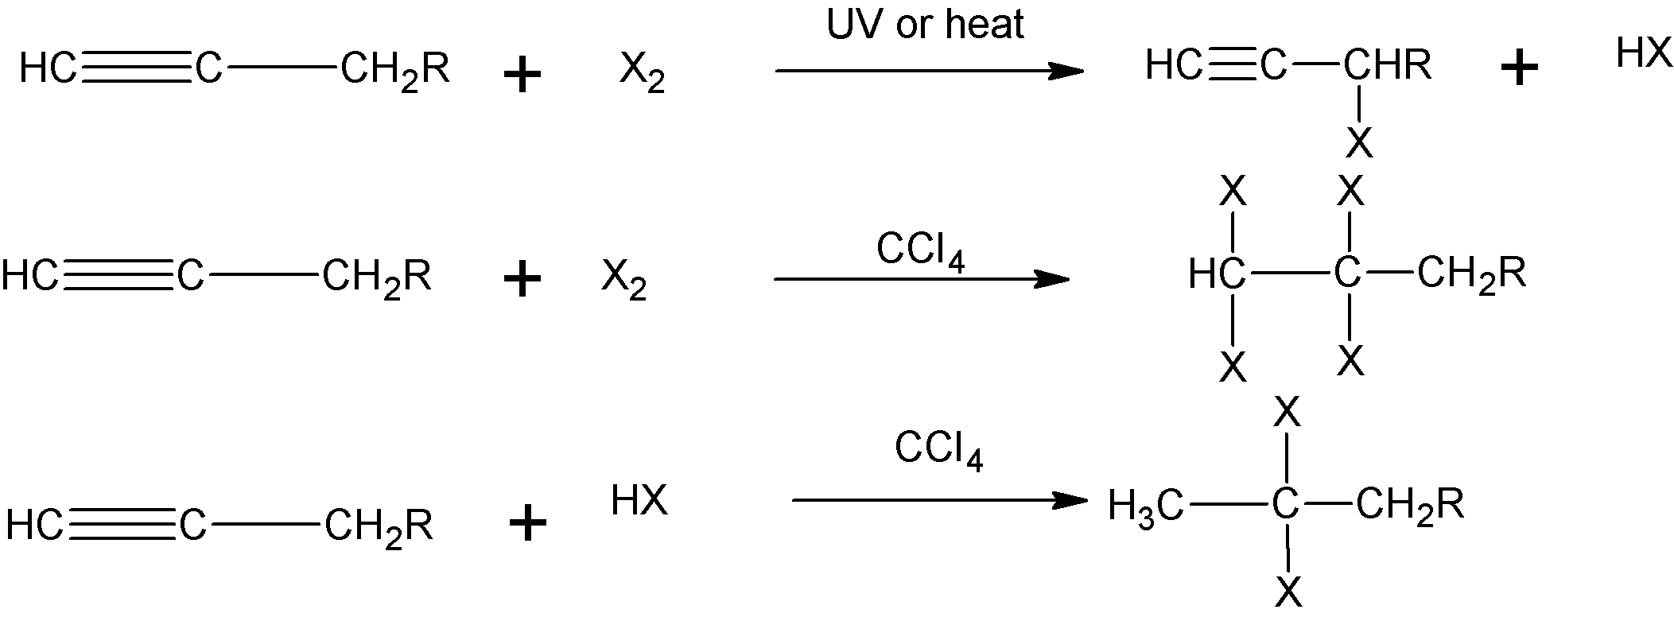
c) Halogenation of alkynes
d) Halogenation of alkyl benzene

Slide 11

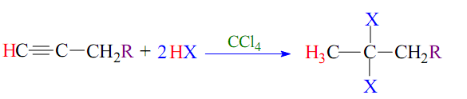
2. Addition of HX to Unsaturated Hydrocarbons
(a) Addition of HX to alkenes:
(b) Addition of HX to alkynes:

Slide 12
2- Conversion Of Alcohols
The hydroxyl group of an alcohol is replaced by halogen on
reaction with concentrated halogen acid (HX), phosphorus halides (PX₃ or PX₅), and thionylchlorid (SOCl₂).

Slide 13
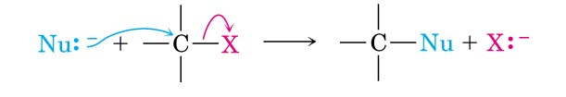
Reactions of Organic Halides
1- Nucleophilic Subtitution Reactions S_{N}
Nu⁻ = ⁻OH, ⁻OR, ⁻OCOR, ⁻SH, ⁻SR, ⁻CN,

Slide 14
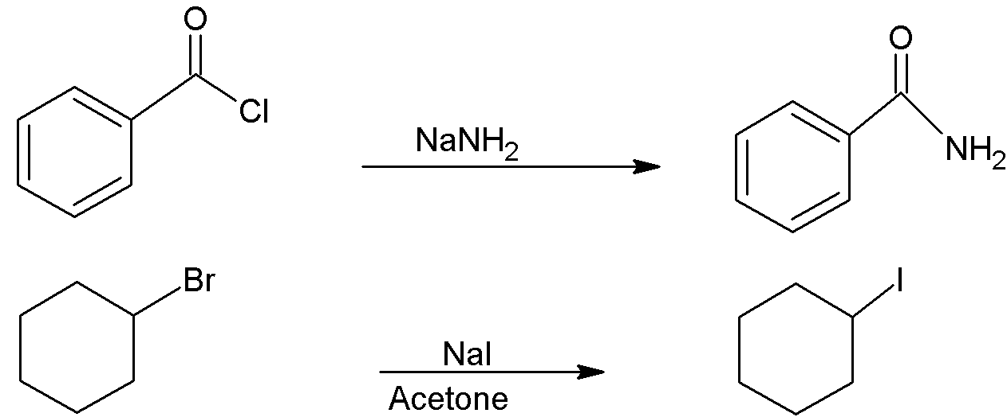

Slide 15
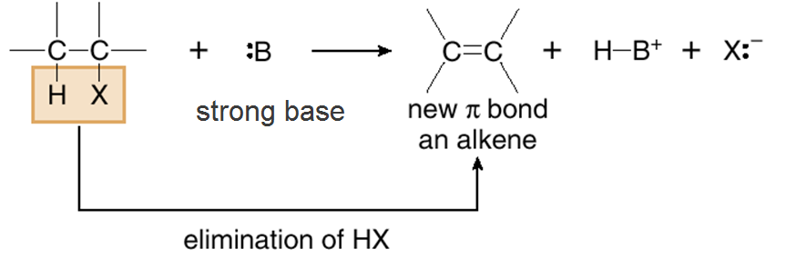
2- Elimination Reactions (E)
Alkyl halides can lose HX molecule to give an alkene.
If the haloalkane is unsymmetrical (e.g. 2-bromobutane or 2-bromopentane) a mixture of isomeric alkene products is obtained.

Slide 16
3- Reaction of Grignared reagent a- Formation of Grignard reagent
b- Reaction of Grignard reagent

Slide 17
4- Reduction of alkyl halides
a) By metal and acid or by metal hydrides
b) By sodium metal (Coupling reaction)(Wurtz reaction)
c) By lithium dialkyl cuprate (Symmetrical and non symmetricalalkane) ( Corey-House (Gilman reagent)

Slide 18
Thank You for your kind attention !

