Slide 1

Chapter One:
The Global Business Environment
1

Slide 2

Objectives
Define business and profits
Describe the external environment
Describe the different types of global economic systems
Demand and supply
Explain how to evaluate the performance of an economic system

Slide 3

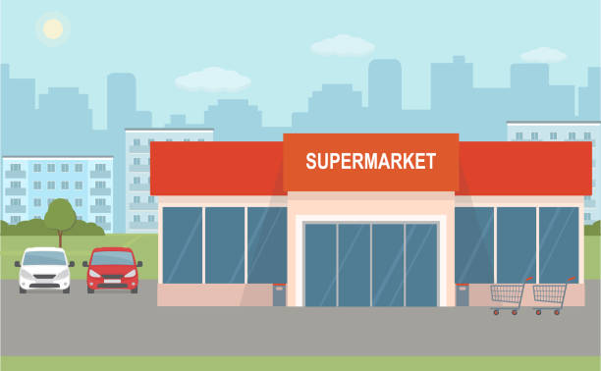

The Concept of Business:
Business: An organization that provides goods or services to earn profits
Notes:
Businesses produce most of the goods and services we consume.
They employ most working people.
They create most new innovations and provide a vast range of opportunities for new businesses.
Many businesses support charities and provide community leadership.

Slide 4
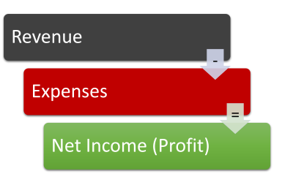
The Concept of Profit:
Profits: are the difference between a business’s revenues and expenses.
Notes:
Profits are the difference between a business’s revenues and expenses.

Slide 5

The Benefits of Business:
Businesses produce most of the goods and services
Businesses create most innovations
Businesses contribute to the quality of life
Businesses create jobs

Slide 6
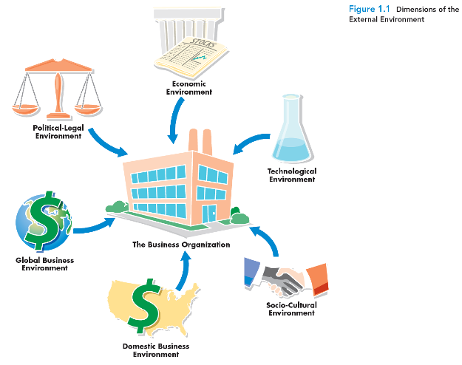
The External Environments of Business
External Environment: Everything outside an organization’s boundaries that might affect it
Notes:
All businesses regardless of their size, location, or mission operate within a larger external environment. This external environment consists of everything outside an organization’s boundaries that might affect it. (Businesses also have an internal environment, more commonly called corporate culture; we discuss this in Chapter 5.)
Not surprisingly, the external environment plays a major role in determining the success or failure of any organization. Managers must, therefore, have a complete and accurate understanding of their environment and then strive to operate and compete within it. Businesses can also influence their environments.
Figure 1.1 shows the major dimensions and elements of the external environment as it affects businesses today.
As you can see, these include the domestic business environment, the global business environment, the technological environment,
the political-legal environment, the socio-cultural environment, and the economic environment. Managers must understand their environment to understand how to operate and compete within it.
The Domestic Business Environment is the environment in which a firm conducts its operations and derives its revenues.
The Global Business Environment encompasses the international forces that affect a business and includes international trade agreements,
international economic conditions, and political unrest.
The Technological Environment encompasses all the ways by which firms create value for their constituents and includes human knowledge,
work methods, physical equipment, electronics and telecommunications.
The Political-Legal Environment is the relationship between business and government.
The Sociocultural Environment includes the customs, mores, values, and demographic characteristics of the society in which an organization functions and determines the goods and services, as well as the standards of business conduct, that a society is likely to value and accept.
The Economic Environment includes relevant conditions that exist in the economic system in which a company operates.
Businesses seek to be close to their customers, to establish strong relationships with their suppliers, and to distinguish themselves from their competitors

Slide 7
The External Environments of Business
The Domestic Business Environment is the environment in which a firm conducts its operations and derives its revenues.
The Global Business Environment encompasses the international forces that affect a business and includes international trade agreements, international economic conditions, and political unrest.
The Technological Environment encompasses all the ways by which firms create value for their constituents
and includes human knowledge, work methods, physical equipment, electronics and telecommunications.
The Political-Legal Environment is the relationship between business and government.
The Sociocultural Environment includes the customs, mores, values, and demographic characteristics of the society in which an organization functions and determines the goods and services, as well as the standards of business conduct, that a society is likely to value and accept.
The Economic Environment includes relevant conditions that exist in the economic system in which a company operates.
Notes:
Managers must understand their environment to understand how to operate and compete within it.
Businesses seek to be close to their customers, to establish strong relationships with their suppliers, and to distinguish themselves from their competitors

Slide 8
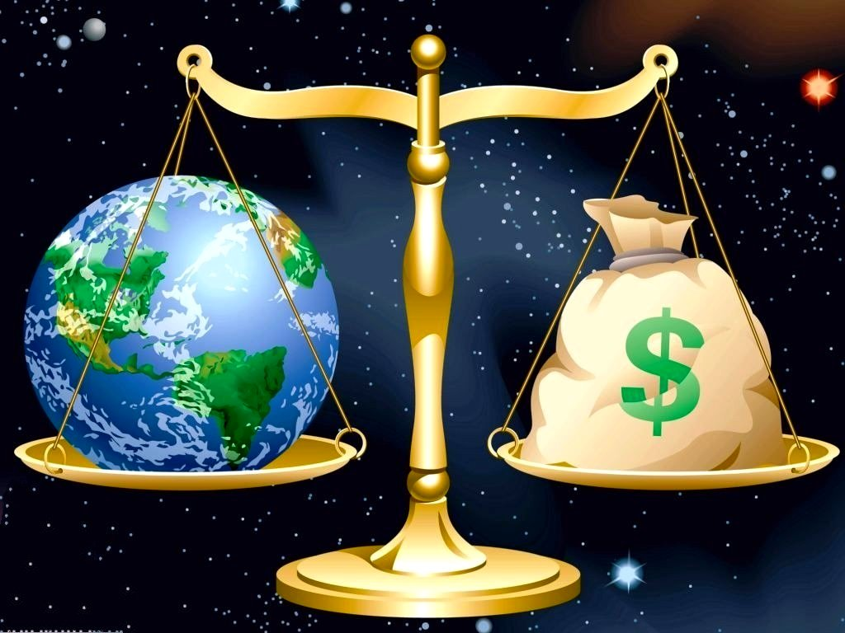
Economic System
A nation’s system for allocating its resources among its citizens, both individuals, and organizations
Notes:
A U.S. business operates differently from a business in France or in the People’s Republic of China. Businesses in these countries similarly differ from those in Japan or Brazil. A key factor in these differences is the economic system of a firm’s home country, the nation in which it does most of its business.
An economic system is a nation’s system for allocating its resources among its citizens, both individuals and organizations.

Slide 9
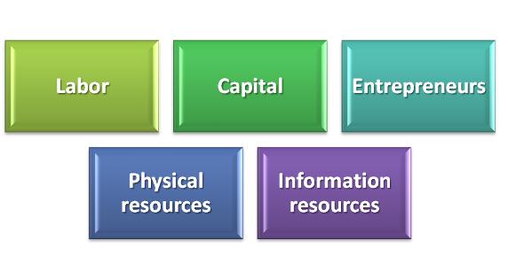
Factors of Production
Factors of production
  the resources that a country’s businesses use to produce goods and services
  A basic difference between economic systems is the way in which a system manages its factors of production
Inputs= factors of production
Outputs= finals products or services
Notes:
Inputs= factors of production
Outputs= finals products or services
Factors of production
the resources that a country’s businesses use to produce goods and services
Labor includes the physical and intellectual contributions people make while engaged in economic production and is also called human resources.
Capital is the term used to describe the financial resources needed to operate a business.
An Entrepreneur is a person who accepts the risks and opportunities entailed in creating and operating a new business venture.
Physical resources are tangible things that organizations use to conduct their business and include natural resources and raw materials, offices,
storage and production facilities, parts and supplies, computers and peripherals.
Information resources are data and other information used by businesses and include market forecasts, the specialized knowledge of people, and economic data.

Slide 10
Factors of Production
(Important Slide Notes)
Labor includes the physical and intellectual contributions people make while engaged in economic production and is also called human resources.
Capital is the term used to describe the financial resources needed to operate a business.
An Entrepreneur is a person who accepts the risks and opportunities associated with creating and operating a new business venture.
Physical resources are tangible things that organizations use to conduct their business and include natural resources and raw materials, offices, storage and production facilities, parts and supplies, computers and peripherals.
Information resources are data and other information used by businesses and include market forecasts, the specialized knowledge of people, and economic data.
Notes:
Inputs= factors of production
Outputs= finals products or services
Factors of production
the resources that a country’s businesses use to produce goods and services
Labor includes the physical and intellectual contributions people make while engaged in economic production and is also called human resources.
Capital is the term used to describe the financial resources needed to operate a business.
An Entrepreneur is a person who accepts the risks and opportunities entailed in creating and operating a new business venture.
Physical resources are tangible things that organizations use to conduct their business and include natural resources and raw materials, offices,
storage and production facilities, parts and supplies, computers and peripherals.
Information resources are data and other information used by businesses and include market forecasts, the specialized knowledge of people, and economic data.

Slide 11
Types of Economic Systems:
Planned Economy | Market Economy | Mixed Market Economies
Economy that relies on a centralized government to control all or most factors of production and to make all or most production and allocation decisions | Individual producers and consumers control production and allocation by creating combinations of supply and demand | Planned + Market economies
Notes:
Different types of economic systems view these factors of production differently. In some systems, for example (and in theory), the ownership of both the factors of production and businesses themselves is private. That is, ownership is held by entrepreneurs, individual investors, and other businesses.
As discussed next, these are market economies. In other systems, though (and also in theory), the factors of production and all businesses are owned or controlled by the government.
These are called planned economies. Note that we described these kinds of systems as being “in theory.” Why? Because in reality, most systems fall between these extremes.
1.
Communism is a system in which the government owns and operates all factors of production
With socialism, the government owns and operates selected major industries
Ex: North Korea
2.
A Market is a mechanism for exchange between the buyers and sellers of a particular good or service.
Market economies rely on capitalism and free enterprise to create an environment in which producers and consumers are free to sell and buy what they choose
In reality, there are really no “pure” planned or “pure” market economies. Most countries rely on some form of mixed market economy that features characteristics of both planned and market economies. Even a market economy that strives to be as free and open as possible, such as the U.S. economy, restricts certain activities. Some products can’t be sold legally, others can be sold only to people of a certain age, advertising must be truthful, and so forth.
3.
When a gov. is making a change from a planned economy to market economy, it begins to adopt market mechanisms through privatization.
Privatization: process of converting government enterprises into privately owned companies
When a government is making a change from a planned economy to a market economy, it usually begins to adopt market mechanisms through privatization, the process of converting government enterprises into privately owned companies. In Poland, for example, the national airline was sold to a group of private investors.
In recent years, this practice has spread to many other countries as well. For example, the postal system in many countries is government-owned and government-managed. The Netherlands, however, privatized its TNT Post Group N.V., and it is already among the world’s most efficient post-office operations. Canada has also privatized its air traffic control system. In each case, the new enterprise reduced its payroll, boosted efficiency and productivity, and quickly became profitable.
More recently the government of Iran has privatized numerous oil refineries and petro-chemical plants that were previously state owned (although they have not revealed their productivity data).

Slide 12
Types of Economic Systems
(Important Slide Notes)
Planned Economy:
  Communism is a system in which the government owns and operates all factors of production
  e.g.: North Korea
  With socialism, the government owns and operates selected major industries
Market Economy:
  Capitalism: a system that sanctions the private ownership of the factors of production and encourages entrepreneurship by offering profits as an incentive
A Market is a mechanism for exchange between the buyers and sellers of a particular good or service.
Market economies rely on capitalism and free enterprise to create an environment in which producers and consumers are free to sell and buy what they choose
Mixed Market Economy:
When a gov. is making a change from a planned economy to market economy, it begins to adopt market mechanisms through privatization.
Privatization: process of converting government enterprises into privately owned companies
Notes:
Inputs= factors of production
Outputs= finals products or services
Factors of production
the resources that a country’s businesses use to produce goods and services
Labor includes the physical and intellectual contributions people make while engaged in economic production and is also called human resources.
Capital is the term used to describe the financial resources needed to operate a business.
An Entrepreneur is a person who accepts the risks and opportunities entailed in creating and operating a new business venture.
Physical resources are tangible things that organizations use to conduct their business and include natural resources and raw materials, offices,
storage and production facilities, parts and supplies, computers and peripherals.
Information resources are data and other information used by businesses and include market forecasts, the specialized knowledge of people, and economic data.

Slide 13
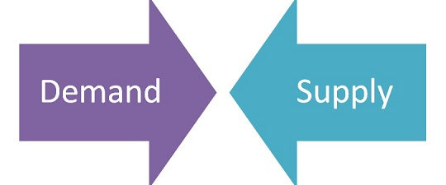
Demand and Supply in a Market Economy
Demand: the willingness and ability of buyers to purchase a product | Supply: the willingness and ability of producers to offer a good or service for sale
The law of demand: Buyers will purchase (demand) more of a product as its price drops and less of a product as its price increases. | The law of supply: Producers will offer (supply) more of a product for sale as its price rises and less of a product as its price drops.

Slide 14
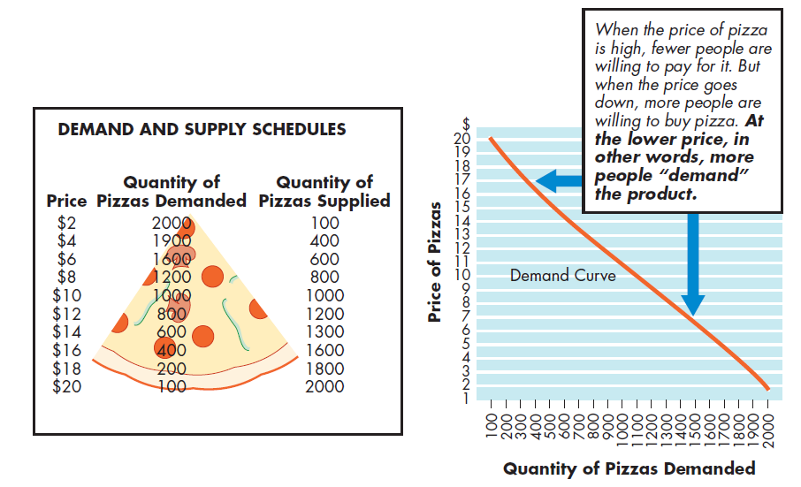
Demand and Supply
Notes:
A Demand and Supply Schedule is an assessment of the relationships among different levels of demand and supply at different price levels
Figure 1.2 shows demand and supply curves for pizzas. As you can see, demand increases as price decreases; supply increases as price increases.

Slide 15
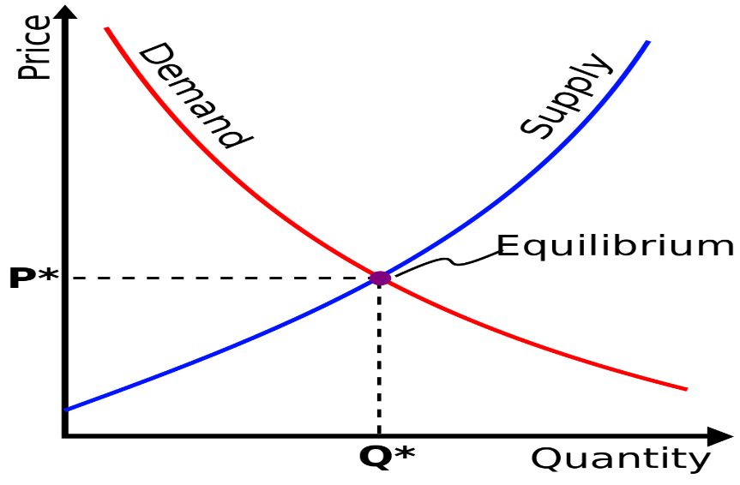
Important Slide Notes
When demand and supply curves are plotted on the same graph, the point at which they intersect is the market price (also called the equilibrium price)—
the price at which the quantity of goods demanded and the quantity of goods supplied are equal.
A Demand Curve is a graph showing how many units of a product will be demanded (bought) at different prices.
A Supply Curve is a graph showing how many units of a product will be supplied (offered for sale) at different prices.
Surplus: situation in which quantity supplied exceeds the quantity demand.
Shortage: situation in which quantity demanded exceeds quantity supplied.
Notes:
When demand and supply curves are plotted on the same graph, the point at which they intersect is the market price (also called the equilibrium price)—
the price at which the quantity of goods demanded and the quantity of goods supplied are equal. In Figure 1.2, the equilibrium price for pizzas in our
example is $10. At this point, the quantity of pizzas demanded and the quantity of pizzas supplied are the same: 1,000 pizzas per week.
A Demand Curve is a graph showing how many units of a product will be demanded (bought) at different prices.
A Supply Curve is a graph showing how many units of a product will be supplied (offered for sale) at different prices.
Surplus: situation in which quantity supplied exceeds the quantity demand.
Shortage: situation in which quantity demanded exceeds quantity supplied.

Slide 16
Private enterprise system
One that allows individuals to pursue their own interests with minimal government restriction
1- Private property rights: ownership of the resources used to create wealth in the hand of individuals
2- Freedom of choice: you can sell your labor to any employer you choose
3- Profits: the lure of profits leads some people to abandon the security of working for someone else and take the risks of entrepreneurship
4- Competition: occurs when two or more businesses vie for the same resources or customers
Notes:
Market economies rely on a private enterprise system—one that allows individuals to pursue their own interests with minimal government restriction. In turn, private enterprise requires the presence of four elements: private property rights, freedom of choice, profits, and competition.

Slide 17

Competition
Competition: occurs when two or more businesses vie for the same resources or customers
Notes:
Competition—the ability to compete for customers and scarce resources.
Even in a free enterprise system, not all industries are equally competitive. Economists have identified four degrees of competition in a private enterprise system: perfect competition, monopolistic competition, oligopoly, and monopoly. Note that these are not always truly distinct categories but actually tend to fall along a continuum; perfect competition and monopoly anchor the ends of the continuum, with monopolistic competition and oligopoly falling in between.
Table 1.1 summarizes the features of these four degrees of competition.

Slide 18
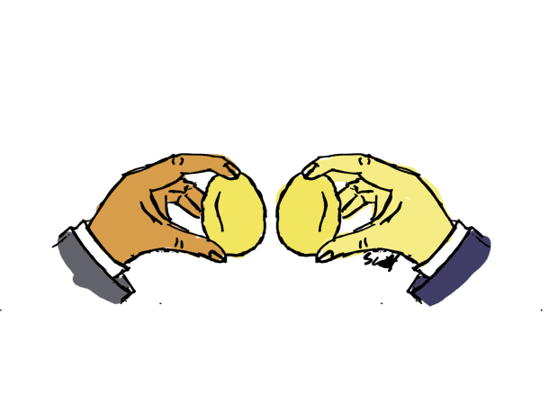
Degrees of Competition: Perfect Competition
For perfect competition to exist, two conditions must prevail:
all firms in an industry must be small, and
the number of firms in the industry must be large
  The products of each firm are so similar or identical
  Buyers and sellers know the prices that others are paying and receiving
  It is easy for firms to enter or leave the market
  Prices are set by supply and demand
perfect competition is characterized by (a) many buyers, (b) many sellers, and (c) buyers and sellers who accept a going price.
Notes:
perfect competition is characterized by (a) many buyers, (b) many sellers, and (c) buyers and sellers who accept a going price.
For perfect competition to exist, two conditions must prevail: (1) all firms in an industry must be small, and (2) the number of firms in the industry must be large. Under these conditions, no single firm is powerful enough to influence the price of its product. Prices are, therefore, determined by such market forces as supply and demand.

Slide 19


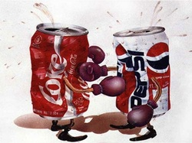
Degrees of Competition: Monopolistic Competition
Market or industry characterized by numerous buyers and relatively numerous sellers trying to differentiate their products from those of competitors
Notes:
monopolistic competition is characterized by (a) many buyers, (b) many sellers, and (c) products that are differentiated.
In monopolistic competition, there are numerous sellers trying to make their products at least seem to be different from those of competitors. Although there are many sellers involved in a monopolistic competition, they tend to be fewer than in pure competition. Differentiating strategies include brand names (Tide versus Cheer versus in-store house brands), design or styling (Diesel versus Lucky versus True Religion jeans), and advertising (Coke versus Pepsi versus Dr. Pepper). For example, in an effort to attract health-conscious consumers, Kraft Foods promotes such differentiated products as low-fat Cool Whip, low-calorie Jell-O, and sugar-free Kool-Aid.

Slide 20


Degrees of Competition: Oligopoly
Market or industry characterized by a handful of (generally large) sellers with the power to influence the prices of their products.
Notes:
oligopoly is characterized by (a) many buyers, (b) few sellers, (c) products that are quite similar, and (d) a change in price by one seller often meaning a change in price by all sellers.
When an industry has only a handful of sellers, an oligopoly exists. As a general rule, these sellers are quite large. The entry of new competitors is hard because large capital investment is needed. Thus, oligopolistic industries (the automobile, airline, and steel industries) tend to stay that way. Only two companies make large commercial aircraft: Boeing (a U.S. company) and Airbus (a European consortium). Furthermore, as the trend toward globalization continues, most experts believe that oligopolies will become increasingly prevalent.

Slide 21

Degrees of Competition: Monopoly
Market or industry in which there is only one producer that can therefore set the prices of its products
Natural Monopoly
  industry in which one company can most efficiently supply all needed goods or services
Notes:
monopoly is characterized by (a) many buyers, (b) only one seller, and (c) prices being set by the one seller.
A monopoly exists when an industry or market has only one producer (or else is so dominated by one producer that other firms cannot compete with it). A sole supplier enjoys complete control over the prices of its products. Its only constraint is a decrease in consumer demand as a result of increased prices. In the United States, laws, such as the Sherman Antitrust Act (1890) and the Clayton Act (1914), forbid many monopolies and regulate prices charged by natural monopolies - industries in which one company can most efficiently supply all needed goods or services. Many electric companies are natural monopolies because they can supply all the power needed in a local area. Duplicate facilities—such as two power plants and two sets of power lines—would be wasteful.

Slide 22
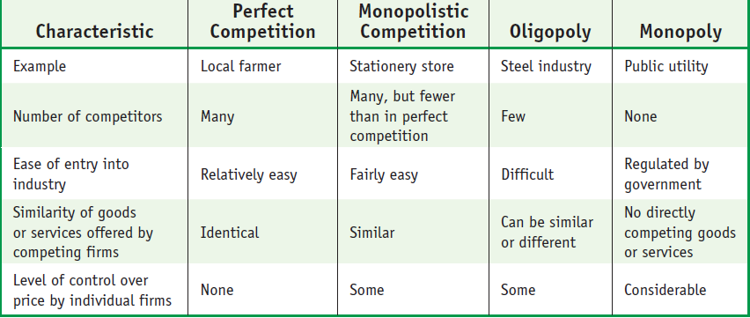
Degrees of Competition
Notes:
Even in a free enterprise system, not all industries are equally competitive. Economists have identified four degrees of competition in a private enterprise system: perfect competition, monopolistic competition, oligopoly, and monopoly. Note that these are not always truly distinct categories but actually tend to fall along a continuum; perfect competition and monopoly anchor the ends of the continuum, with monopolistic competition and oligopoly falling in between.
The table summarizes the features of these four degrees of competition.

Slide 23

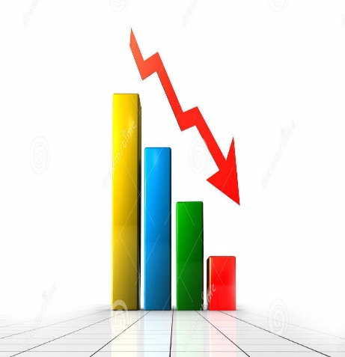
Economic Indicators
  statistics that show whether an economic system is strengthening, weakening, or remaining stable
  help assess the performance of an economy
Notes:
Because economic forces are so volatile and can be affected by so many things, the performance of a country’s economic system varies over time. Sometimes it gains strength and brings new prosperity to its members (this describes the U.S. economy during the early years of the twenty-first century); other times it weakens and damages their fortunes (as was the case in the years 2009–2010). Clearly then, knowing how an economy is performing is useful for both, business owners and investors alike.

Slide 24
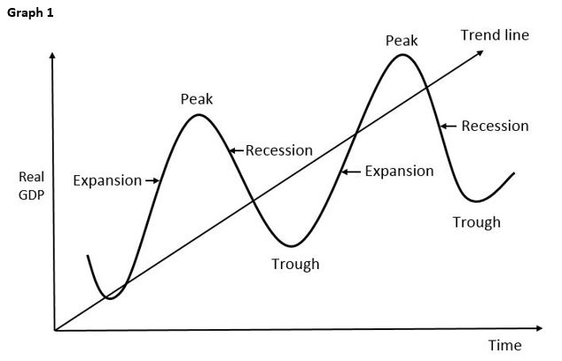
Economic Growth, Aggregate Output, and Standard of Living
Business cycle: the pattern of short-term ups and downs (or expansions and contractions) in an economy
Aggregate output
  the total quantity of goods and services produced by an economic system during a given period
  primary measure of growth in the business cycle
Standard of living: the total quantity and quality of goods and services that they can purchase with the currency used in their economic system
24
Notes:
Fundamentally, how do we know whether an economic system is growing or not? Experts call the pattern of short-term ups and downs (or, better, expansions and contractions) in an economy the business cycle. The primary measure of growth in the business cycle is aggregate output or the total quantity of goods and services produced by an economic system during a given period.
standard of living increases when the quantity of goods and services increases, and the economic system provides more of the goods and services people want.
To put it simply, an increase in aggregate output is growth (or economic growth). When output grows more quickly than the population, two things usually follow:
• Output per capita—the quantity of goods and services per person—goes up.
• The system provides more of the goods and services that people want.
When these two things occur, people living in an economic system benefit from a higher standard of living, which refers to the total quantity and quality of goods and services that they can purchase with the currency used in their economic system.

Slide 25
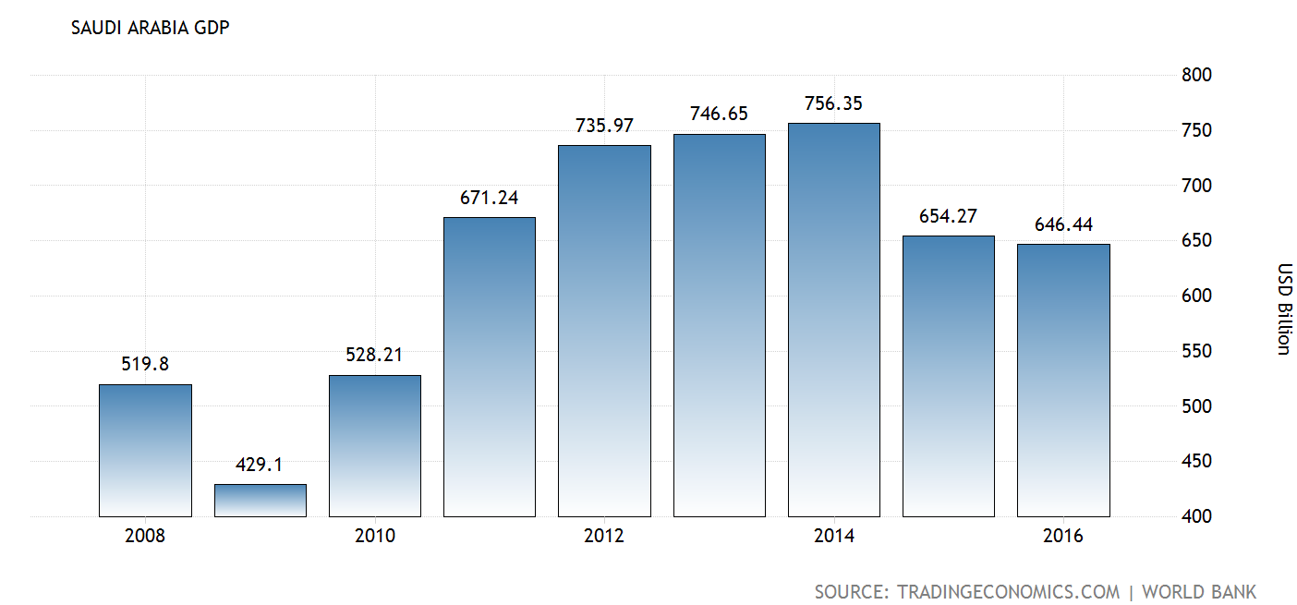
Gross Domestic Product (GDP)
refers to the total value of all goods and services produced within a given period by a national economy through domestic factors of production
measure of aggregate output (primary measure of growth) if GDP is going UP aggregate output is going up, the nation is experiencing economic growth
Notes:
gross domestic product includes only the value of products produced within a nation’s borders
Gross domestic product (GDP) refers to the total value of all goods and services produced within a given period by a national economy through domestic factors of production. GDP is a measure of the aggregate output. Generally speaking, if the GDP is going up, aggregate output is going up; or in other words, if the aggregate output is going up, the nation is experiencing economic growth.

Slide 26
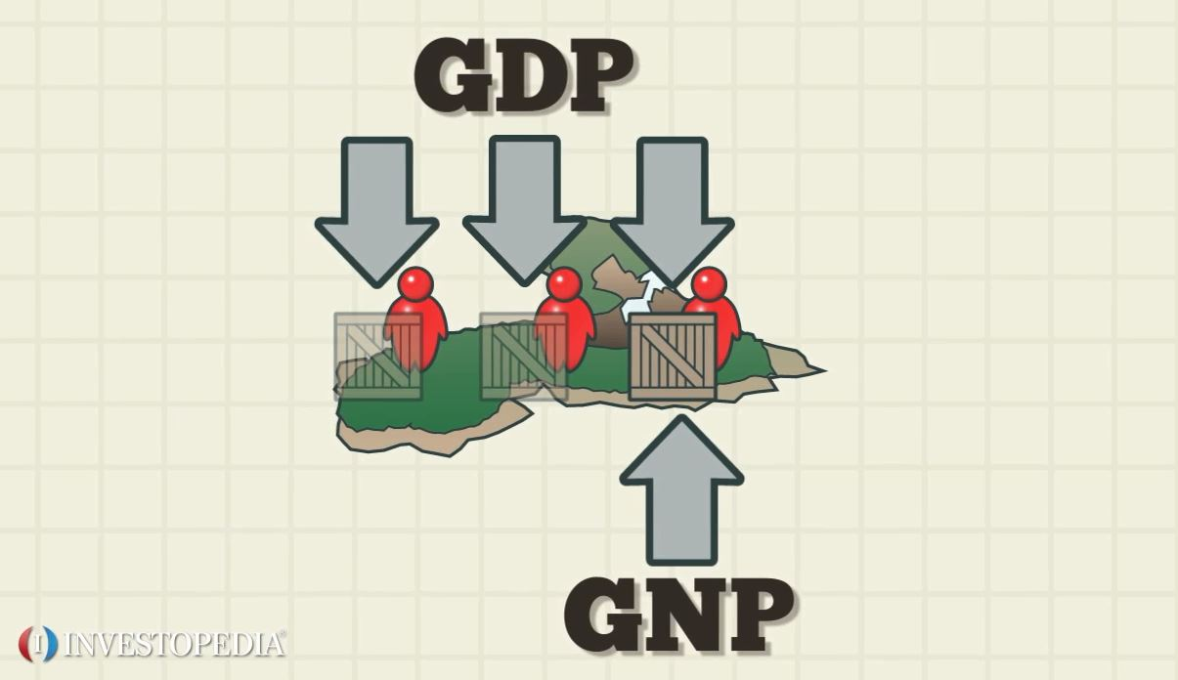
Gross National Product (GNP)
Refers to the total value of all goods and services produced by a national economy within a given period regardless of where the factors of production are located.
Notes:
gross national product includes the value of products produced by a country regardless of where they are produced
Sometimes, economists also use the term gross national product (GNP), which refers to the total value of all goods and services produced by a national economy within a given period of time, regardless of where the factors of production are located. What, precisely, is the difference between GDP and GNP?
Consider a General Motors automobile plant in Brazil. The profits earned by the factory are included in U.S. GNP—but not in GDP—because its output is not produced domestically (that is, in the United States). Conversely, those profits are included in Brazil’s GDP—but not GNP—because they are produced domestically (that is, in Brazil).
Calculations quickly become complex because of the different factors of production. The labor, for example, will be mostly Brazilian but the capital will be mostly American. Thus, the wages paid to Brazilian workers are part of Brazil’s GNP even though the profits are not.

Slide 27
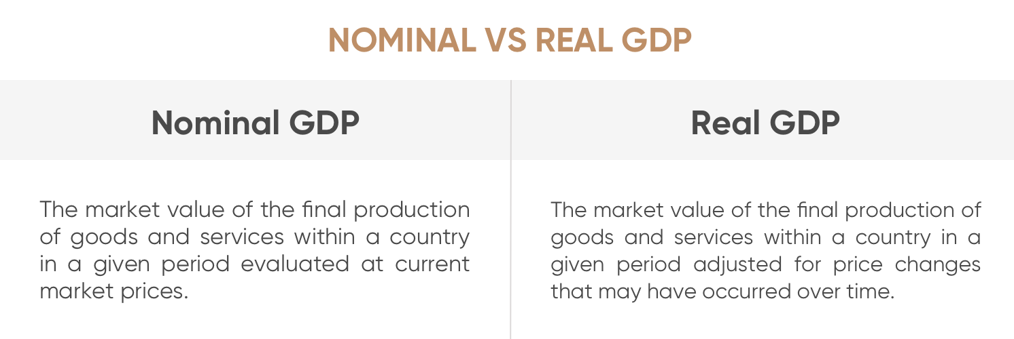
Nominal GDP Vs Real GDP
in a given period evaluated at the prices of base year
Purchasing Power Parity (PPP)
The principle that exchange rates are set so that the prices of similar products in different countries are about the same
Notes:
We calculate real GDP when we adjust GDP to account for changes in currency values and price changes. When we make this adjustment, we account for both GDP and purchasing power parity, or the principle that exchange rates are set so that the prices of similar products in different countries are about the same. Purchasing power parity gives us a much better idea of what people can actually buy with the financial resources allocated to them by their respective economic systems. In other words, it gives us a better sense of standards of living across the globe.

Slide 28
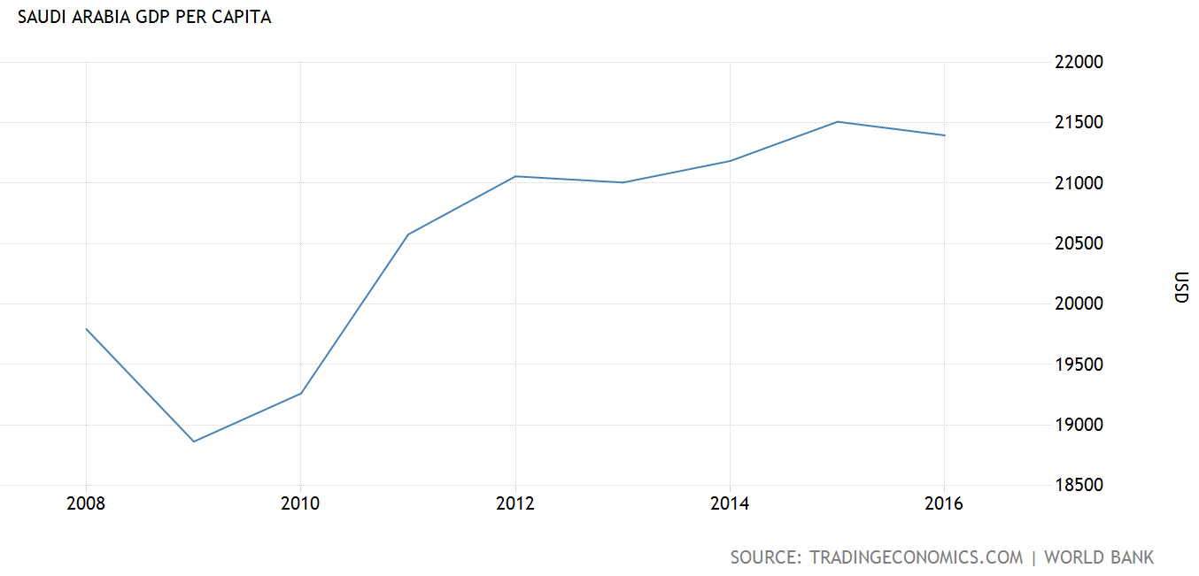
GDP per Capita
Per Capita GDP = GDP/Population
GDP per capita is a better measure than GDP itself of the economic well-being of the average person.
Notes:
GDP per capita is a better measure than GDP itself of the economic well-being of the average person.

Slide 29
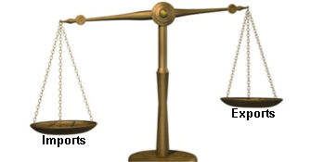
Productivity
measure of economic growth that compares how much a system produces with the resources needed to produce it
Balance of Trade: the economic value of all the products that a country exports minus the economic value of its imported products
  Positive or negative?
National Debt: the amount of money the government owes its creditors
A positive balance of trade results when a country exports (sells to other countries) more than it imports (buys from other countries).
A negative balance of trade results when a country imports more than it exports.
Notes:
A positive balance of trade results when a country exports (sells to other countries) more than it imports (buys from other countries).
A negative balance of trade results when a country imports more than it exports.
A major factor in the growth of an economic system is productivity, which is a measure of economic growth that compares how much a system produces with the resources needed to produce it. Let’s say that it takes 1 U.S. worker and 1 U.S. dollar to make 10 soccer balls in an 8-hour workday. Let’s also say that it takes 1.2 Saudi workers and the equivalent of 1.5 dollars in Riyals, the currency of Saudi Arabia, to make 10 soccer balls in the same 8-hour workday. We can say that the U.S. soccer-ball industry is more productive than the Saudi soccer-ball industry. The two factors of production in this extremely simple case are labor and capital.
A positive balance of trade results when a country exports (sells to other countries) more than it imports (buys from other countries).
A negative balance of trade results when a country imports more than it exports.

Slide 30
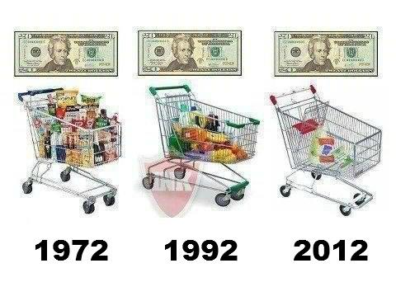
Economic Stability
Stability: condition in which the amount of money available in an economic system and the quantity of goods and services produced in it are growing at about the same rate
Inflation: occurs when widespread price increases occur throughout an economic system
- Inflation can be measured by the consumer price index (CPI)
Consumer Price Index (CPI)
  a measure of the prices of typical products purchased by consumers living in urban areas
Notes:
Inflation can be measured by the consumer price index (CPI), which weighs prices of typical products purchased by consumers living in urban areas.
A chief goal of an economic system, stability can be threatened by certain factors.
Inflation occurs when an economic system experiences widespread price increases. Instability results when the amount of money injected into an economy exceeds the increase in actual output, so people have more money to spend but the same quantity of products available to buy. As supply and demand principles tell us, as people compete with one another to buy available products, prices go up.
These high prices will eventually bring the amount of money in the economy back down. However, these processes are imperfect—the additional money will not be distributed proportionately to all people, and price increases often continue beyond what is really necessary. As a result, purchasing power for many people declines.

Slide 31
Managing The US Economy
Fiscal Policies
  Policies Used by the government regarding how it collects and spends revenue
Monetary Policies
  Policies used by a government to control the size of its money supply
Stabilization Policy: government economic policy intended to smooth out fluctuations in output and unemployment and to stabilize prices
Notes:
The government acts to manage the U.S. economic system through two sets of policies: fiscal and monetary. It manages the collection and spending of its revenues through fiscal policies. Tax rates, for example, can play an important role in fiscal policies helping to manage the economy. One key element of President Obama’s presidential platform was an overhaul of the U.S. tax system. Among other things, he proposed cutting taxes for the middle class while simultaneously raising taxes for both higher-income people and businesses.
Monetary policies focus on controlling the size of the nation’s money supply. Working primarily through the Federal Reserve System (the nation’s central bank, often referred to simply as “the Fed”), the government can influence the ability and willingness of banks throughout the country to lend money. For example, to help offset the 2008 recession, the government injected more money into the economy through various stimulus packages. On the one hand, officials hoped that these funds would stimulate business growth and the creation of new jobs. On the other hand, though, some experts feared that increasing the money supply might also lead to inflation.
Taken together, fiscal policy and monetary policy make up the stabilization policy, defined as the government economic policy in which the goal is to smooth out fluctuations in output and unemployment and to stabilize prices. In effect, the economic recession that started in 2008 was a significant departure from stabilization as business valuations dropped and jobs were eliminated. The various government interventions, such as financial bailouts, represented strategies to restore economic stability.

Slide 32

Economic Stability
Unemployment
  the level of joblessness among people actively seeking work in an economic system
Notes:
Finally, we need to consider the effect of unemployment on economic stability. Unemployment is the level of joblessness among people actively seeking work in an economic system. When unemployment is low, there is a shortage of labor available for businesses to hire. As businesses compete with one another for the available supply of labor, they raise the wages they are willing to pay. Then, because higher labor costs eat into profit margins, they raise the prices of their products. Although consumers have more money to inject into the economy, this increase is soon undone by higher prices, so purchasing power declines.
When we go through a period during which aggregate output declines, we have a recession. During a recession, producers need fewer employees—less labor—to produce products. Unemployment, therefore, goes up. To determine whether an economy is going through a recession, we start by measuring aggregate output. Recall that this is the function of real GDP, which we find by making necessary adjustments to the total value of all goods and services produced within a given period by a national economy through domestic factors of production. A recession is more precisely defined as a period during which aggregate output, as measured by real GDP, declines.
A prolonged and deep recession is called a depression. The last major depression in the United States started in 1929 and lasted more than 10 years. Most economists believe that the 2008–2011 recession, although the worst in decades, was not really a depression.

Slide 33
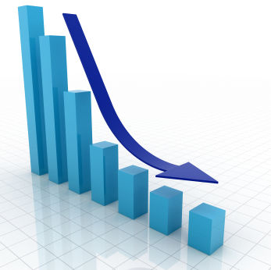
Economic Stability
Recession
  a period during which aggregate output, as measured by GDP, declines
Depression
  a prolonged and deep recession
Notes:
When we go through a period during which aggregate output declines, we have a recession. During a recession, producers need fewer employees—less labor—to produce products. Unemployment, therefore, goes up. To determine whether an economy is going through a recession, we start by measuring aggregate output. Recall that this is the function of real GDP, which we find by making necessary adjustments to the total value of all goods and services produced within a given period by a national economy through domestic factors of production. A recession is more precisely defined as a period during which aggregate output, as measured by real GDP, declines.
A prolonged and deep recession is called a depression. The last major depression in the United States started in 1929 and lasted more than 10 years. Most economists believe that the 2008–2011 recession, although the worst in decades, was not really a depression.

Slide 34
References
Griffin, R. W., & Ebert, R. J. (2016). Business Essentials, Global Edition, 11th Edition. Pearson Education.
34

